Slide 1
Python programming
unit B2 – logistic regression

Slide 2




Logistic regression
For the set of sample data, there is one dependent which only possible of two values (categorical).
The other feature is continuous variable.
For the dependent variable, suppose the success outcome is with probability $p$, failure outcome is with probability ($1−p$)
This is a sigmoid function (s-curve).
Multi variables:
$$ln\left(\frac{p}{1−p}\right)=m+kx$$
$$p(y=1)=\frac{1}{1+e^{−(m+kx)}}$$
$$p(y=1)=\frac{1}{1+e^{−(m+\sum_{i}{k_{i}x_{i}})}}$$

Slide 3
Packages to use
Scikit-learn
Linear_model.LogisticRegression()
statsmodels
Logit(), add_constant()

Slide 4
dataset
The exam data
One column data: study time
Target data: exam passed or not
Heart disease data
Several columns' data: demographic, behavioural, medical.
Target data: in 10 years time will have coronary heart disease or not.
Dataset from the book “Mastering Python Data Analysis”, by Luiz Felipe Martins
studytime = [0, 0, 1.5, 2, 2.5, 3, 3.5, 4, 4, 4, 5.5, 6, 6.5, 7, 7, 8.5, 9, 9, 9, 10.5, 10.5, 12, 12, 12, 12.5, 13, 14, 15, 16, 18]
passed = [0, 0, 0, 0, 0, 0, 0, 0, 0, 0, 0, 1, 0, 1, 1, 0, 1, 1, 0, 1, 1, 1, 1, 1, 1, 1, 1, 1, 1, 1]
https://www.kaggle.com/dileep070/heart-disease-prediction-using-logistic-regression

Slide 5
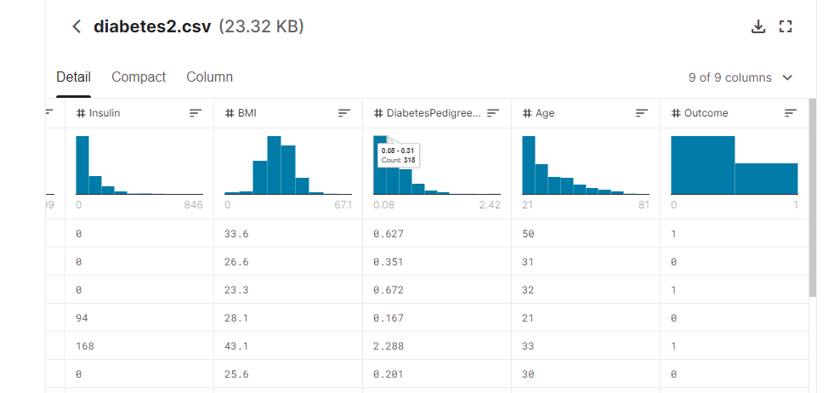
tasks
Diabetics prediction dataset
https://www.kaggle.com/kandij/diabetes-datasetb
Use the diabetics dataset, and use logistic regression, to build model to predict if have diabetics or not.

